Slide 1

Graphics

Slide 2
Frame Windows
To show a frame:
1. Construct an object of the JFrame class:
JFrame frame = new JFrame();
2. Set the size of the frame:
frame.setSize(300, 400);
3. If you'd like, set the title of the frame:
frame.setTitle("An empty Frame");
4. Set the "default close operation":
frame.setDefaultCloseOperation(JFrame.EXIT_ON_CLOSE);
5. Make the frame visible:
frame.setVisible(true);

Slide 3
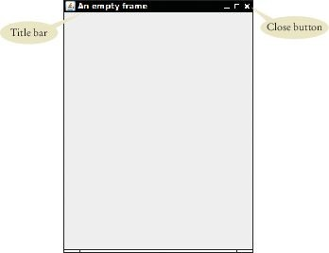
section_9_1/EmptyFrameViewer.java
1 import javax.swing.JFrame;
2
3 public class EmptyFrameViewer
4 {
5 public static void main(String[] args)
6 {
JFrame frame = new JFrame();
frame.setSize(300, 400);
frame.setTitle("An empty frame");
frame.setDefaultCloseOperation(JFrame.EXIT_ON_CLOSE);
frame.setVisible(true);
12 }
13 }
Figure 20 A Frame Window

Slide 4
Drawing on a Component
In order to display a drawing in a frame, define a class that extends the
JComponent class.
Place drawing instructions inside the paintComponent method.
That method is called whenever the component needs to be repainted:
public class RectangleComponent extends JComponent
{
public void paintComponent(Graphics g)
{
Drawing instructions go here
}
}

Slide 5
Classes Graphics and Graphics2D
Graphics class stores the graphics state (such as current color).
Graphics2D class has methods to draw shape objects.
Use a cast to recover the Graphics2D object from the Graphics
parameter:
public class RectangleComponent extends JComponent
{
public void paintComponent(Graphics g)
{
// Recover Graphics2D Graphics2D g2 = (Graphics2D) g;
. . .
}
}

Slide 6
Classes Graphics and Graphics2D
The draw method of the Graphics2D class draws shapes, such as rectangles, ellipses, line segments, polygons, and arcs:
public class RectangleComponent extends JComponent
{
public void paintComponent(Graphics g)
{
. . .
Rectangle box = new Rectangle(5, 10, 20, 30); g2.draw(box);
. . .
}
}

Slide 7
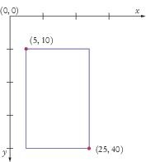
Coordinate System of a Component
The origin (0, 0) is at the upper-left corner of the component. The y-coordinate grows downward.

Slide 8
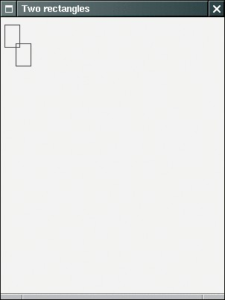
Drawing Rectangles
We want to create an application to display two rectangles.
Figure 2 Drawing Rectangles

Slide 9
section_9_2/RectangleComponent.java
import java.awt.Graphics;
import java.awt.Graphics2D;
import java.awt.Rectangle;
import javax.swing.JComponent;
5
6 /*
7
8
9
10
11
12
13
14
15
16
17
18
19
20
21
22
23
24
25
26 }
A component that draws two rectangles.
*/
public class RectangleComponent extends JComponent
{
public void paintComponent(Graphics g)
{
// Recover Graphics2D
Graphics2D g2 = (Graphics2D) g;
// Construct a rectangle and draw it
Rectangle box = new Rectangle(5, 10, 20, 30); g2.draw(box);
// Move rectangle 15 units to the right and 25 units down
box.translate(15, 25);
// Draw moved rectangle
g2.draw(box);
}

Slide 10
Displaying a Component in a Frame
In a graphical application you need:
A frame to show the application A component for the drawing.
The steps for combining the two:
Construct a frame object and configure it.
Construct an object of your component class:
RectangleComponent component = new RectangleComponent();
3. Add the component to the frame:
frame.add(component);
4. Make the frame visible.

Slide 11
section_9_3/RectangleViewer.java
1 import javax.swing.JFrame;
2
3 public class RectangleViewer
4 {
5 public static void main(String[] args)
6 {
7 JFrame frame = new JFrame();
8
9
10
11
12
13
14
15
16
17
18 }
frame.setSize(300, 400); frame.setTitle("Two rectangles");
frame.setDefaultCloseOperation(JFrame.EXIT_ON_CLOSE);
RectangleComponent component = new RectangleComponent(); frame.add(component);
frame.setVisible(true);
}

Slide 12
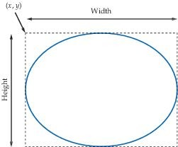
Ellipses
To construct an ellipse, you specify its bounding box.
Figure 22 An Ellipse and Its Bounding Box
To construct an Ellipse:
Ellipse2D.Double ellipse = new Ellipse2D.Double(x, y, width, height);

Slide 13
Ellipses
Ellipse2D.Double is an inner class — doesn't matter to us except for the import statement:
import java.awt.geom.Ellipse2D; // No .Double
To draw the shape:
g2.draw(ellipse);

Slide 14
Circles
To draw a circle, set the width and height to the same values:
Ellipse2D.Double circle = new Ellipse2D.Double(x, y, diameter, diameter); g2.draw(circle);
(x, y) is the top-left corner of the bounding box, not the center of the circle.

Slide 15
Lines
To draw a line, specify its end points:
Line2D.Double segment = new Line2D.Double(x1, y1, x2, y2); g2.draw(segment);
or
Point2D.Double from = new Point2D.Double(x1, y1); Point2D.Double to = new Point2D.Double(x2, y2); Line2D.Double segment = new Line2D.Double(from, to); g2.draw(segment);

Slide 16

Drawing Text
To draw text, use the drawString method
Specify the string and the x- and y-coordinates of the basepoint of the first character
g2.drawString("Message", 50, 100);
Figure 23 Basepoint and Baseline

Slide 17
Colors
To draw in color, you need to supply a Color object.
Specify the amount of red, green, blue as values between 0 and 255:
Color magenta = new Color(255, 0, 255);
The Color class declares a variety of colors:
Color.BLUE, Color.RED, Color.PINK etc.
To draw a shape in a different color
First set color in graphics context:
g2.setColor(Color.Red);
g2.draw(circle); // Draws the shape in red

Slide 18
Colors - continued
To color the inside of the shape, use the fill method:
g2.fill(circle); // Fills with current color
When you set a new color in the graphics context, it is used for subsequent drawing operations.

Slide 19
Predefined Colors
Color
RGB Value
Color.BLACK
0, 0, 0
Color.BLUE
0, 0, 255
Color.CYAN
0, 255, 255
Color.GRAY
128, 128, 128
Color.DARK_GRAY
64, 64, 64
Color.LIGHT_GRAY
192, 192, 192
Color.GREEN
0, 255, 0
Color.MAGENTA
255, 0, 255
Color.ORANGE
255, 200, 0
Color.PINK
255, 175, 175
Color.RED
255, 0, 0
Color.WHITE
255, 255, 255
Color.YELLOW
255, 255, 0

Slide 21
Shape Classes
Good practice: Make a class for each part of a drawing that occurs more than once.
public class Car
{
public Car(int x, int y)
{
// Remember position
. . .
}
public void draw(Graphics2D g2)
{
// Drawing instructions
. . .
}
}

Slide 22
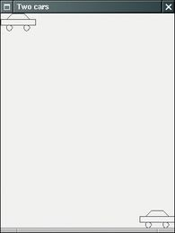
Drawing Cars
Goal: draw two cars - one in top-left corner of window, and another in the bottom right.
Figure 8 The Car Component Draws Two Car Shapes

Slide 23
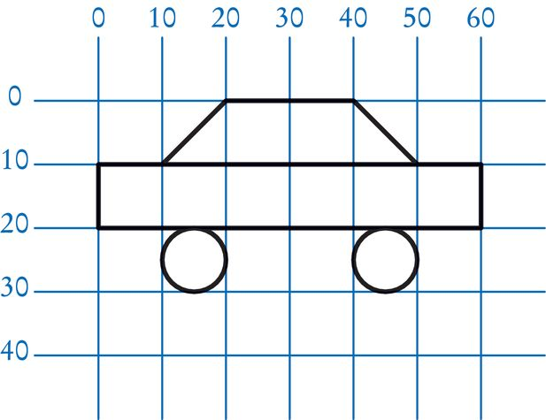
Plan Complex Shapes on Graph Paper
Figure 9 Using Graph Paper to Find Shape Coordinates

Slide 24
Drawing Cars
The program that produces the drawing is composed of three classes:
The Car class is responsible for drawing a single car.
Two objects of this class are constructed, one for each car.
The CarComponent class displays the drawing.
The CarViewer class shows a frame that contains a
CarComponent.

Slide 25
Drawing Cars
The paintComponent method of the CarComponent class draws the two cars.
To compute bottom right position:
Car car1 = new Car(0, 0); int x = getWidth() - 60; int y = getHeight() - 30; Car car2 = new Car(x, y);
getWidth and getHeight return the dimensions of the CarComponent Subtract the dimensions of the car to determine the position of car2:
When window is resized
paintComponent is called
car position is recomputed using current dimensions

Slide 26
section_8/Car.java
1 | import java.awt.Graphics2D;
2 | import java.awt.Rectangle;
3 | import java.awt.geom.Ellipse2D;
4 | import java.awt.geom.Line2D;
5 | import java.awt.geom.Point2D;
6
7 | /**
8 | A car shape that can be positioned anywhere on the screen.
9 | */
10 | public class Car
11 | {
12 | private int xLeft;
13 | private int yTop;
14
15 | /**
16 | Constructs a car with a given top left corner.
17 | @param x the x coordinate of the top left corner
18 | @param y the y coordinate of the top left corner
19 | */
20 | public Car(int x, int y)
21 | {
22 | xLeft = x;
23 | yTop = y;
24 | }
25
26 | /**
27 | Draws the car.
28 | @param g2 the graphics context
29 | */
30 | public void draw(Graphics2D g2)
31 | {
32 | Rectangle body = new Rectangle(xLeft, yTop + 10, | 60, 10);
33 | Ellipse2D.Double frontTire
34 | = new Ellipse2D.Double(xLeft + 10, yTop + 20, | 10, 10);
35 | Ellipse2D.Double rearTire

Slide 27
section_8/CarComponent.java
1 import java.awt.Graphics;
2 import java.awt.Graphics2D;
3 import javax.swing.JComponent;
4
5 /**
6 This component draws two car shapes.
7 */
8 public class CarComponent extends JComponent
9 {
10 public void paintComponent(Graphics g)
11 {
12 Graphics2D g2 = (Graphics2D) g;
13
14 Car car1 = new Car(0, 0);
15
16 int x = getWidth() - 60;
17 int y = getHeight() - 30;
18
19 Car car2 = new Car(x, y);
20
21 car1.draw(g2);
22 car2.draw(g2);
23 }
24 }

Slide 28
section_8/CarViewer.java
1 import javax.swing.JFrame;
2
3 public class CarViewer
4 {
5 public static void main(String[] args)
6 {
7 JFrame frame = new JFrame();
8
9 frame.setSize(300, 400);
10 frame.setTitle("Two cars");
11 frame.setDefaultCloseOperation(JFrame.EXIT_ON_CLOSE);
12
13 CarComponent component = new CarComponent();
14 frame.add(component);
15
16 frame.setVisible(true);
17 }
18 }

Slide 29
Self Check 3.27
Which class needs to be modified to have the two cars positioned next to each other?
Answer: CarComponent

Slide 30
Self Check 3.28
Which class needs to be modified to have the car tires painted in black, and what modification do you need to make?
Answer: In the draw method of the Car class, call
g2.fill(frontTire); g2.fill(rearTire);

Slide 31
Self Check 3.29
How do you make the cars twice as big?
Answer: Double all measurements in the draw method of the Car
class.

Slide 33
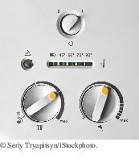
Event Handling
In an event-driven user interface, the program receives an event whenever the user manipulates an input component.
User interface events include key presses, mouse moves, button clicks, and so on.
Most programs don't want to be flooded by irrelevant events. A program must indicate which events it needs to receive.

Slide 34
Event Handling
Event listeners:
A program indicates which events it needs to receive by installing event listener objects Belongs to a class provided by the application programmer
Its methods describe the actions to be taken when an event occurs Notified when event happens
Event source:
User interface component that generates a particular event
Add an event listener object to the appropriate event source
When an event occurs, the event source notifies all event listeners

Slide 35
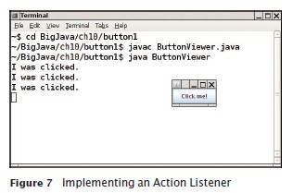
Events Handling
Example: A program that prints a message whenever a button is clicked. Button listeners must belong to a class that implements the ActionListener
interface:
public interface ActionListener
{
void actionPerformed(ActionEvent event);
}
Your job is to supply a class whose actionPerformed method contains the instructions that you want executed whenever the button is clicked.

Slide 36
section_7_1/ClickListener.java
import java.awt.event.ActionEvent;
import java.awt.event.ActionListener;
3
4
5
6
7
8
9
10
11
12
13
/**
An action listener that prints a message.
*/
public class ClickListener implements ActionListener
{
public void actionPerformed(ActionEvent event)
{
System.out.println("I was clicked.");
}
}

Slide 37
Event Handling - Listening to Events
event parameter of actionPerformed contains details about the event, such as the time at which it occurred.
Construct an object of the listener and add it to the button:
ActionListener listener = new ClickListener(); button.addActionListener(listener);
Whenever the button is clicked, it calls:
listener.actionPerformed(event);
And the message is printed.
Use a JButton component for the button; attach an ActionListener to the button.

Slide 38
section_7_1/ButtonViewer.java
import java.awt.event.ActionListener;
import javax.swing.JButton;
import javax.swing.JFrame;
/**
This program demonstrates how to install an action listener.
*/
public class ButtonViewer
{
private static final int FRAME_WIDTH = 100;
private static final int FRAME_HEIGHT = 60;
public static void main(String[] args)
{
JFrame frame = new JFrame();
JButton button = new JButton("Click me!");
frame.add(button);
ActionListener listener = new ClickListener();
button.addActionListener(listener);
frame.setSize(FRAME_WIDTH, FRAME_HEIGHT);
frame.setDefaultCloseOperation(JFrame.EXIT_ON_CLOSE);
frame.setVisible(true);
}
}

Slide 39
Using Inner Classes for Listeners
Implement simple listener classes as inner classes like this:
JButton button = new JButton(". . .");
// This inner class is declared in the same method as the button variable class MyListener implements ActionListener
{
. . .
}
ActionListener listener = new MyListener(); button.addActionListener(listener);
Advantages
Places the trivial listener class exactly where it is needed, without cluttering up the remainder of the project
Methods of an inner class can access instance variables and methods of the surrounding class:

Slide 40
Using Inner Classes for Listeners
Local variables that are accessed by an inner class method must be declared as
final (or in Java 8, effectively final [not modified after initialized]).
Example: add interest to a bank account whenever a button is clicked:
JButton button = new JButton("Add Interest"); frame.add(button);
final BankAccount account = new BankAccount(INITIAL_BALANCE);
class AddInterestListener implements ActionListener
{
public void actionPerformed(ActionEvent event)
{
// The listener method accesses the account variable
// from the surrounding block
double interest = account.getBalance() * INTEREST_RATE / 100; account.deposit(interest);
}
}
ActionListener listener = new AddInterestListener(); button.addActionListener(listener);

Slide 41
Self Check 10.28
When do you call the actionPerformed method?
Answer: You don’t. It is called whenever the button is clicked.

Slide 42
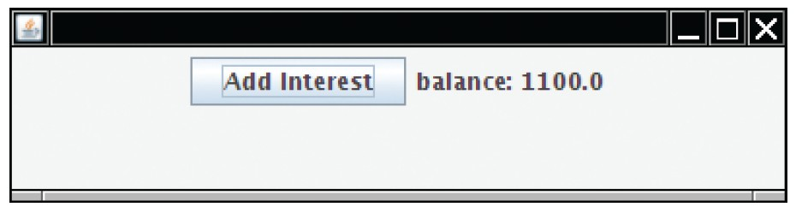
Building Applications with Buttons
Example: investment viewer program; whenever button is clicked, interest is added, and new balance is displayed:
Construct an object of the JButton class:
JButton button = new JButton("Add Interest");
We need a user interface component that displays a message:
JLabel label = new JLabel("balance: " + account.getBalance());
Use a JPanel container to group multiple user interface components together:
JPanel panel = new JPanel(); panel.add(button); panel.add(label); frame.add(panel);

Slide 43
Building Applications with Buttons
AddInterestListener class adds interest and displays the new balance:
class AddInterestListener implements ActionListener
{
public void actionPerformed(ActionEvent event)
{
double interest = account.getBalance() * INTEREST_RATE / 100; account.deposit(interest);
label.setText("balance=" + account.getBalance());
}
}
Add AddInterestListener as inner class so it can have access to surrounding variables (prior to Java 8, account and label must be declared final).

Slide 44
Processing Timer Events
javax.swing.Timer generates equally spaced timer events, sending events to installed action listeners.
Useful whenever you want to have an object updated in regular intervals. Declare a class that implements the ActionListener interface:
class MyListener implements ActionListener
{
void actionPerformed(ActionEvent event)
{
Listener action (executed at each timer event)
}
}
To create a timer, specify the frequency of the events and an object of a class that implements the ActionListener interface:
MyListener listener = new MyListener();
Timer t = new Timer(interval, listener);
t.start();

Slide 45
Mouse Events
Use a mouse listener to capture mouse events.
Implement the MouseListener interface which has five methods:
public interface MouseListener
{
void mousePressed(MouseEvent event);
// Called when a mouse button has been pressed on a component void mouseReleased(MouseEvent event);
// Called when a mouse button has been released on a component void mouseClicked(MouseEvent event);
// Called when the mouse has been clicked on a component void mouseEntered(MouseEvent event);
// Called when the mouse enters a component
void mouseExited(MouseEvent event);
// Called when the mouse exits a component
}

Slide 46
Mouse Events
Add a mouse listener to a component by calling the addMouseListener
method:
public class MyMouseListener implements MouseListener
{
// Implements five methods
}
MouseListener listener = new MyMouseListener();
component.addMouseListener(listener);
Sample program: enhance RectangleComponent – when user clicks on rectangle component, move the rectangle to the mouse location.

Slide 47
Mouse Events
Call repaint to tell the component to repaint itself and show the rectangle in its new position.
When the mouse is pressed,the mouse listener moves the rectangle to the mouse location:
class MousePressListener implements MouseListener
{
public void mousePressed(MouseEvent event)
{
int x = event.getX();
int y = event.getY();
component.moveTo(x, y);
}
// Do-nothing methods
public void mouseReleased(MouseEvent event) {}
public void mouseClicked(MouseEvent event) {}
public void mouseEntered(MouseEvent event) {}
public void mouseExited(MouseEvent event) {}
}
All five methods of the interface must be implemented; unused methods can be empty.

